Slide 1

IoT Security 101

Slide 2
Who AM I?
LinkedIn – @iamrakeshnaik
Career – Senior Security Analyst at Alliant Cybersecurity
Interested in Defensive side of security such as Cloud Security, Incident Response, Security Engineering, and Network Security.

Slide 3
Topics
Introduction to IoT Security
Common IoT Security Challenges
Types of IoT Security Threats
Mitigations/Best Practices for IoT Security
Future of IoT Security
Conclusion

Slide 4
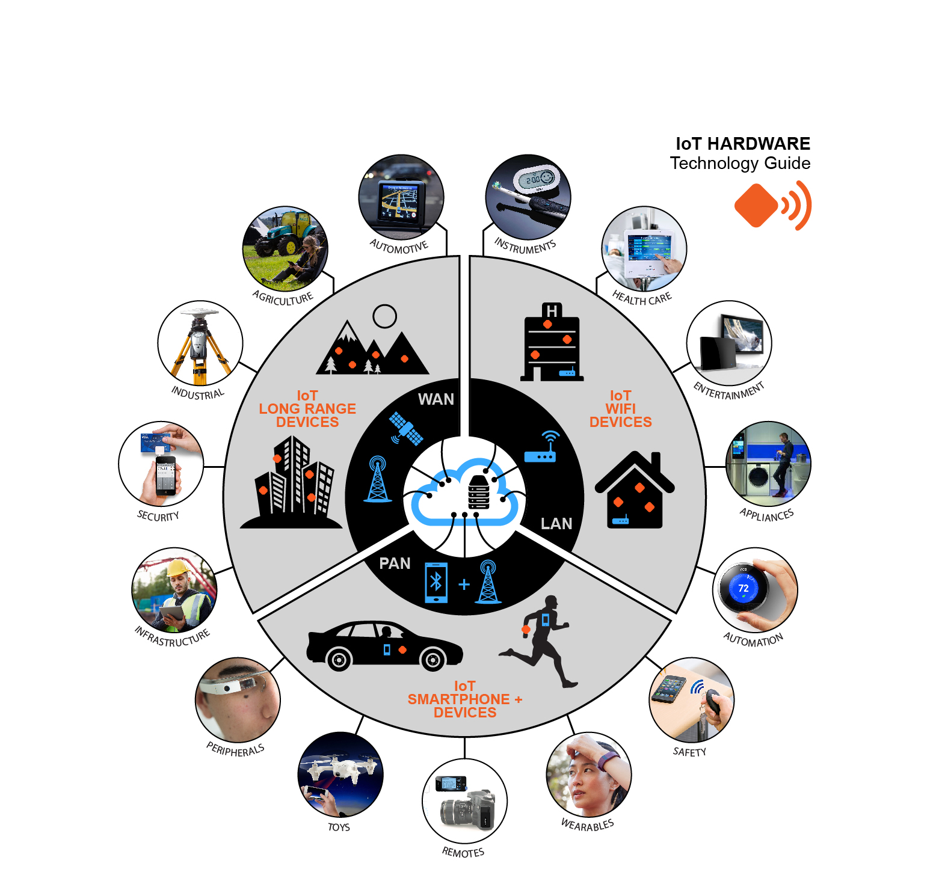
Introduction to IoT Security
What is IoT
The Internet of Things (IoT) refers to the interconnected network of physical devices that collect and exchange data.
Importance of IoT Security
With the increasing number of connected devices, securing these devices is crucial to prevent unauthorized access and data breaches.
Implementing robust IoT security measures is crucial to prevent data breaches, protect privacy, and ensure the safe operation of connected devices

Slide 5

Common IoT Security Challenges
Weak authentication and authorization
Lack of encryption
Vulnerabilities in firmware and software
Insecure communications
Difficulty in patching and updating devices

Slide 6
Types of IoT Security Threats
Denial of Service (DoS)
Overwhelming the IoT Devices with huge traffic than it can handle.
Botnet Attacks
Using the Compromised IoT Devices to join a Botnet and Launch DDos Attacks.
Supply Chain Attacks
This involves compromising the integrity of IoT devices through vulnerabilities in the supply chain, potentially embedding malware before the devices reach end-users
Firmware Hijacking
Attackers may exploit outdated firmware by injecting malicious code during updates, allowing them control over the device
Malware and ransomware attacks
IoT devices can be infected with malware, leading to data theft or device malfunction.

Slide 7
Mitigations/Best Practices for IoT Security
Implement Strong Authentication Mechanisms:
Use strong, unique passwords and multi-factor authentication
Use Encryption for Data Transmission:
Encrypt data both in transit and at rest
Regularly Update and Patch Devices:
Ensure devices are regularly updated with the latest security patches
Monitor Network Traffic for Unusual Activity:
Use network monitoring tools to detect and respond to suspicious activity
Segment IoT Devices on Separate Networks:
Isolate IoT devices from critical networks to limit the impact of a breach

Slide 8
Future of IoT Security
Advanced Data Encryption:
Data encryption will be critical in safeguarding sensitive information transmitted between IoT devices and backend systems. Protocols like TLS/SSL will be widely adopted to prevent eavesdropping and tampering, making it significantly harder for attackers to access data.
AI-Driven Security Solutions:
Artificial Intelligence (AI) will play a pivotal role in enhancing IoT security. AI algorithms can analyze vast amounts of data generated by IoT devices, enabling automated threat detection and response, predictive maintenance, and real-time anomaly identification. This proactive approach will help organizations stay ahead of potential threats.
Enhanced Device Authentication:
As IoT devices proliferate, robust authentication methods will become essential. Techniques such as cryptographic keys, biometric authentication, and secure digital certificates will ensure that only authorized devices can connect to networks, reducing the risk of unauthorized access

Slide 9
Conclusion
Check for default/ weak credentials.
Patch regularly.
Enable encryption.
Isolate the IoT devices in the Network.
Monitor the traffic inbound and outbound from IoT devices.

Slide 10
Recent Example
Hackers take control of robot vacuums in multiple cities, yell racial slurs
Presentation: Sucking dust and cutting grass: reversing robots and bypassing security - media.ccc.de

Slide 11

Thank You

